Slide 1
Project Schedule Formatting Fundamentals
Microsoft Project 2013
Lesson 8

Slide 2
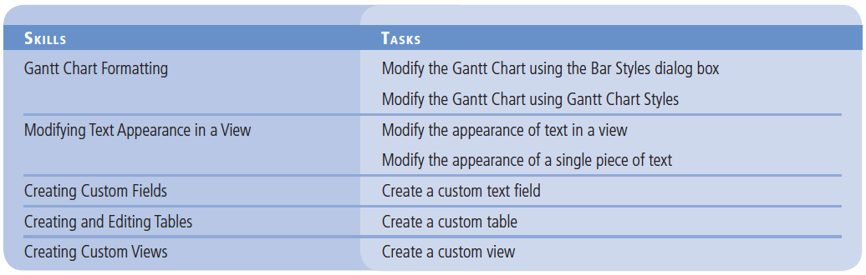
Objectives

Slide 3
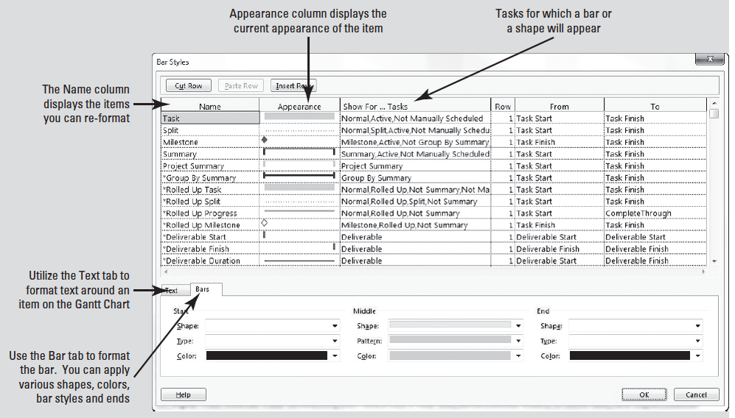
Software Orientation
In Microsoft Project, you can use the Bar Styles dialog box (see the figure below) to customize the appearance of items on the Gantt Chart.

Slide 4
Software Orientation
This dialog box enables you to change the appearance of items such as task bars, milestones, summary bars, and text that appear on the Gantt Chart.
You can change characteristics such as bar types, patterns, colors, splits, and shapes.

Slide 5
Software Orientation
You will now use one of the features of the ribbon interface in Project 2013, the Format ribbon.
With this ribbon you have faster access to formatting options in views.
You may have seen in the various views of previous lessons a tab at the very top of the screen, above the ribbon.
This is the Format ribbon. This tab provides formatting options available in the view you are in at the time.
The figure below shows the Format ribbon for the Gantt Chart view.

Slide 6
Gantt Chart Formatting
The Gantt Chart view consists of two parts: a table on the left and a bar chart on the right.
The default formatting of the Gantt Chart view is useful for onscreen project schedule viewing and printing. However, you are able to change the formatting of almost any element on the Gantt Chart to suit your needs.
You can format whole categories of Gantt Chart task bars via the Bar Styles dialog box, or you can format individual Gantt Chart task bars directly.
In this exercise, you will modify several items on the Gantt Chart using the Bar Styles dialog box.

Slide 7
Step by Step: Modify the Gantt Chart Using the Bar Styles Dialog Box
GET READY. OPEN the Don Funk Music Video 8M project schedule. SAVE the file as Don Funk Music Video 8.
1. Click the Format tab, then in the Bar Styles group click the down-arrow under the Format button. Select Bar Styles from the dropdown list. The Bar Styles dialog box appears.
2. In the Name column, select Milestone. You want to change the shape of the milestones on the Gantt Chart.

Slide 8
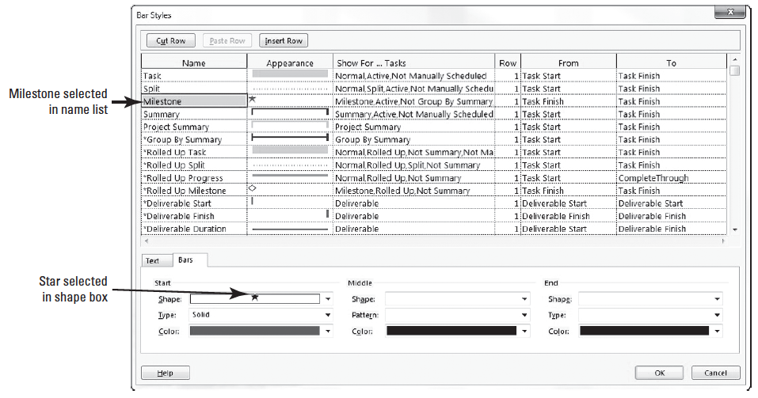
Step by Step: Modify the Gantt Chart Using the Bar Styles Dialog Box
3. In the bottom half of the dialog box under the Start label, locate the Shape box. Select the star shape from the dropdown list in the Shape box. Note that the star shape now appears in the Appearance column for Milestone. Your screen should look similar to the figure below.

Slide 9
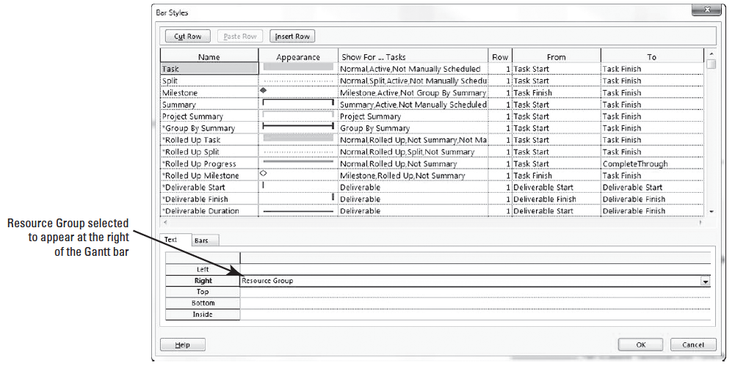
Step by Step: Modify the Gantt Chart Using the Bar Styles Dialog Box
4. In the Name column at the top of the dialog box, select Task.
5. In the bottom half of the dialog box, click the Text tab. You want to make a change to display the resource groups assigned rather than full names next to the task bars.
6. In the Text tab, in the Right box, select Resource Names, click the down-arrow, and then select Resource Group. Your screen should look similar to the figure below.

Slide 10
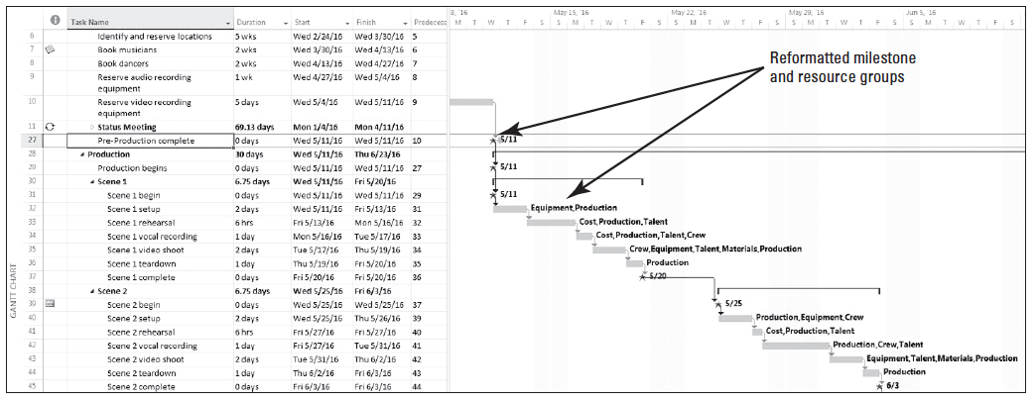
Step by Step: Modify the Gantt Chart Using the Bar Styles Dialog Box
7. Click OK to close the Bar Styles dialog box. Microsoft Project applies the formatting changes you made to the Gantt Chart.
8. Select the name cell of Task 27, Pre-Production complete. Press Crtl+Shift+F5. This is the keyboard shortcut for Scroll to Task. Microsoft Project scrolls the Gantt Chart bar view to task 27, where you can see the reformatted milestones and resource groups. Your screen should look similar to the figure below.

Slide 11
Step by Step: Modify the Gantt Chart Using the Bar Styles Dialog Box
9. SAVE the project schedule.
PAUSE. LEAVE the project schedule open to use in the next exercise.
The Gantt Chart became the standard for visualizing project schedules in the early twentieth century when American engineer and management consultant Henry L. Gantt developed a bar chart with two main principles; 1) to measure activities by the amount of time needed to complete them; and 2) to represent the amount of the activity that should have been done in a given time.
In Microsoft Project, the Gantt Chart view is the default view. A view is a window through which you can see various elements of your project schedule.
The two main view categories are named single view, which you have been using mostly throughout the lessons, and one you will see later in this lesson called a combination view.
Views are made up of one or more view elements.
Notes:
Take Note: With the Bar Styles dialog box, the formatting changes you make to a type of item (a milestone, for example) apply to all such items in the Gantt Chart.

Slide 12
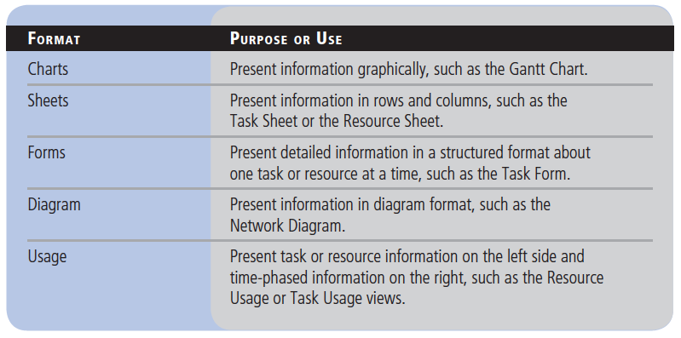
Step by Step: Modify the Gantt Chart Using the Bar Styles Dialog Box
The five different view formats and their common use are listed in the table below.

Slide 13
Modifying the Gantt Chart Using Gantt Chart Styles
In this exercise, you will create a custom Gantt Chart, format it using predefined Gantt Chart Styles, and save the custom view.

Slide 14
Step by Step: Modify the Gantt Chart Using Gantt Chart Styles
USE the project schedule you created in the previous exercise.
1. Click the Format tab, under Gantt Chart Tools, if necessary.
2. In the Show/Hide group, click the Project Summary Task box.
3. Press the F5 key. In the ID box, type 0 and click OK. Microsoft Project displays the project summary task (task ID 0) at the top of the Gantt Chart view. Now you will make a few adjustments to your screen so that all of the summary task information is visible.
4. Drag the vertical divider bar between the table and chart to the right until at least the Duration and Start columns are visible, if necessary.
Notes:
Another Way: You can also double-click the divider bar to snap the divider to the nearest column edge.

Slide 15
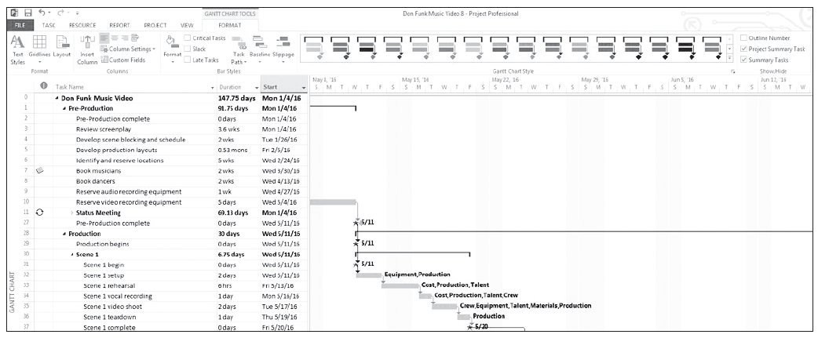
Step by Step: Modify the Gantt Chart Using Gantt Chart Styles
5. Double-click the right edge of the Task Name column, in the column heading, to expand the column so that you can see the entire value. Readjust the vertical divider bar, as necessary. Your screen should look similar to the figure below. Before you make further formatting changes, you will make a copy of the Gantt Chart view so that you will not affect the original Gantt Chart view.
Notes:
Another Way: Right-clicking anywhere in a column heading will activate the sub-menu for column. Selecting Field Settings will display the Field Settings dialog box. In the dialog box, click the Best Fit button to automatically adjust the column width.

Slide 16
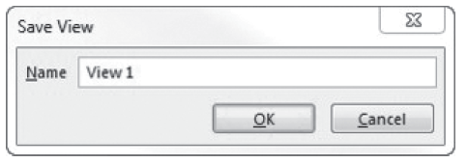
Step by Step: Modify the Gantt Chart Using Gantt Chart Styles
6. Click the View tab. In the Task Views group, click the down-arrow under the Gantt Chart button then select Save View. The Save View dialog box appears with View 1 as the default name as in the figure below.

Slide 17
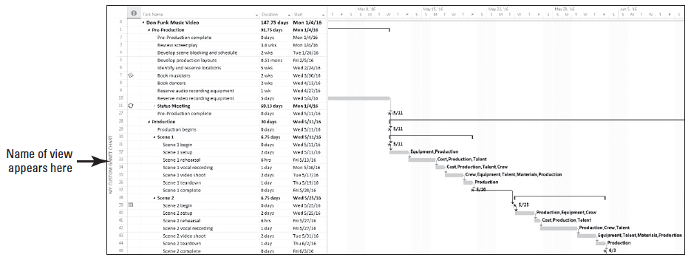
Step by Step: Modify the Gantt Chart Using Gantt Chart Styles
7. In the Name Field, type My Custom Gantt Chart, and then click OK. The Save View dialog box closes. Note that the name of the new view is listed on the left edge of your screen. Your screen should look similar to the figure below.

Slide 18
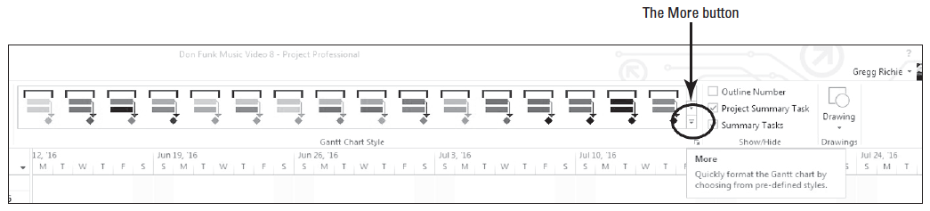
Step by Step: Modify the Gantt Chart Using Gantt Chart Styles
8. Click the Format tab. In the Gantt Chart Styles group, click the More button located at the lower right of the bar graphics, as shown in th figure below.

Slide 19
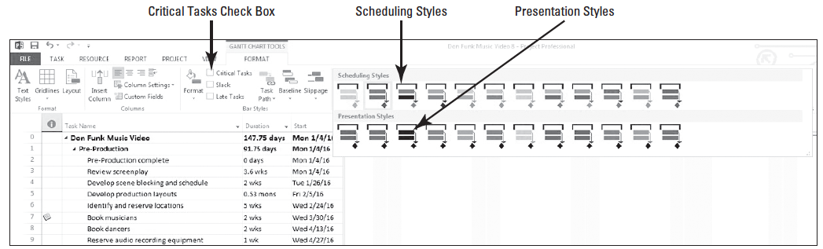
Step by Step: Modify the Gantt Chart Using Gantt Chart Styles
9. The predefined Gantt Chart Style options appear as in the figure below. These are divided into two style categories, one for scheduling and one for presentations. Select the second style in the scheduling category.

Slide 20
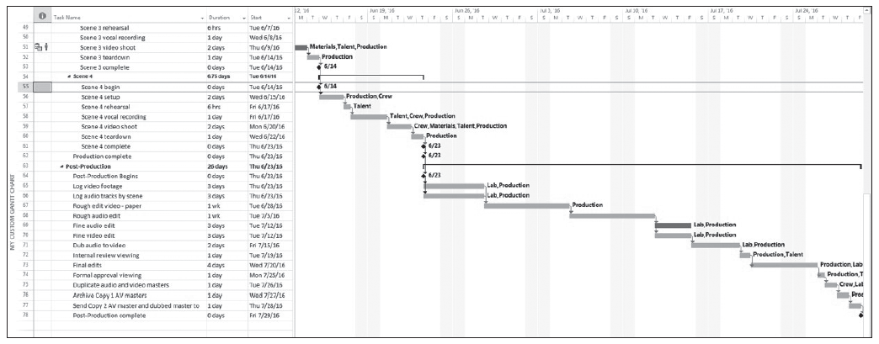
Step by Step: Modify the Gantt Chart Using Gantt Chart Styles
10. On the Format ribbon, in the Bar Styles group, click the check box for Critical Tasks.
11. Press the F5 key. In the ID box key 55 and press Enter. Notice that most tasks from 52-78 are formatted to display in red. Your screen should look similar to the figure below.
Notes:
Take Note: Notice that the Resource Groups are still displayed to the right of the Gantt bars, but the Milestones have been changed back the default diamond shape.

Slide 21
Step by Step: Modify the Gantt Chart Using Gantt Chart Styles
12. SAVE the project schedule.
PAUSE. LEAVE the project schedule open to use in the next exercise.
In this exercise, you made formatting changes to your project schedule using predefined Gantt Chart Styles.
This is similar to making changes using the Bar Styles command; however, the predefined Gantt Chart Styles has fewer choices than the Bar Styles command.
As you are reviewing the formatting changes in the My Custom Gantt Chart view, remember that none of the data in the project schedule has changed–just the way it is formatted.
These formatting changes affect only the My Custom Gantt Chart view; all other views in Microsoft Project are unaffected.

Slide 22
Modifying Text Appearance In a View
Microsoft Project enables you to change the way text appears within a view.
You can modify the appearance of an entire category of tasks, such as summary tasks or milestones, or you can change the appearance of an individual cell.
This feature allows you to call attention to specific items or to offset a specific type of task with color and font size or type.

Slide 23
Step by Step: Modify the Appearance of Text in a View
USE the project schedule you created in the previous exercise.
1. Click the Task tab, click the down-arrow under the Gantt Chart button and select More Views. The More Views dialog box appears.
2. In the More Views box, select Task Sheet, and then click Apply. The Detail Gantt view appears.
3. Press the F5 key. In the ID box, type 0 and then press Enter. This brings you to the top of the Gantt Chart.
Notes:
Another Way: You can also right-click the view name bar at the left edge of the screen and select More Views from the dropdown menu.

Slide 24
Step by Step: Modify the Appearance of Text in a View
4. Click the Format tab under Text Sheet Tools. Then in the Format group click Text Styles. The Text Styles dialog box appears.
5. In the Items to Change: box, click the sub-menu arrow and select Summary Tasks from the list
6. In the Font: box, leave the default font type as it is. In the Font Style: box, select Bold Italic.
7. In the Size: box, select 12 as the font size.

Slide 25
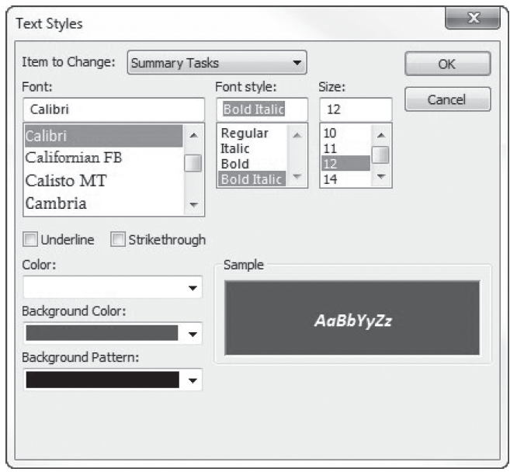
Step by Step: Modify the Appearance of Text in a View
8. In the Color: box, select White.
9. In the Background Color: box select dark blue (ScreenTip will show as Blue, Darker 50%). Your Text Styles dialog box will look similar to the figure at right.

Slide 26
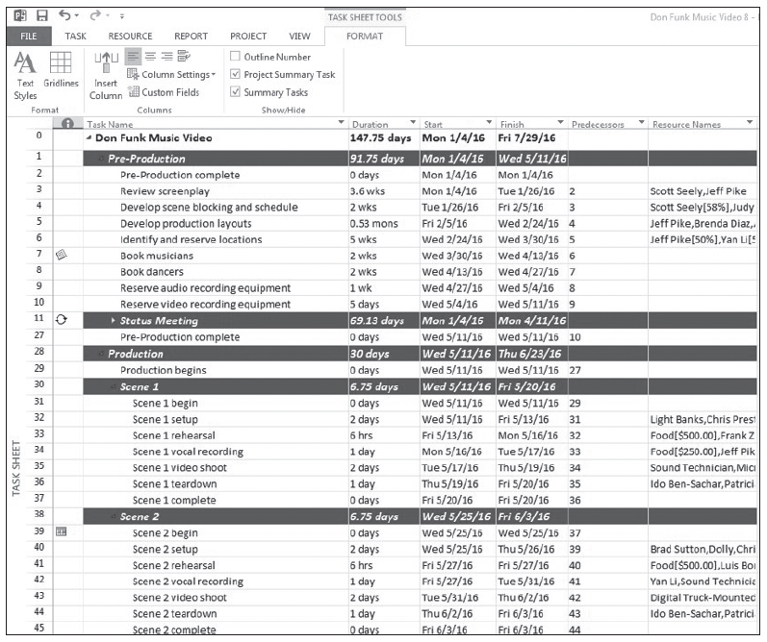
Step by Step: Modify the Appearance of Text in a View
10. Click OK. Microsoft Project changes the formatting of all summary tasks to the attributes you specified. Your screen should look similar to the figure at right.
11. SAVE the project schedule.
PAUSE. LEAVE the project schedule open to use in the next exercise.
Notes:
Take Note: Notice that the Project summary task was not reformatted. This is because the Project Summary task is a separate category and must be reformatted by itself.

Slide 27
Modifying the Appearance of a Single Piece of Text
In this exercise, you will modify a single piece of text in the Task Sheet view using the cost table.

Slide 28
Step by Step: Modify the Appearance of a Single Piece of Text
USE the project schedule you created in the previous exercise.
1. On the ribbon, click the View tab. In the Data group click the Tables button and then select Cost.
2. Auto fit all the columns to see all the data. Select the Total Cost cell for task 38, Scene 2.
3. Select the Task tab and then, in the Font group, click the expand button at the lower-right corner of that group. The Font dialog box appears.
Notes:
Troubleshooting: The tables in Microsoft Project may look like Microsoft Excel but there are distinct differences. For example, you can auto-fit all columns in Excel at the same time, but you cannot in do this in Microsoft Project.

Slide 29
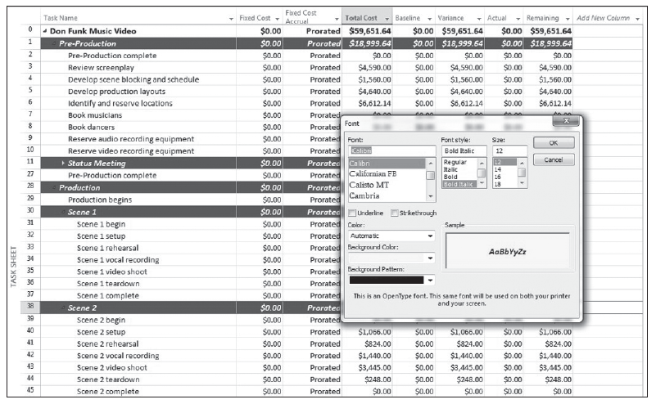
Step by Step: Modify the Appearance of a Single Piece of Text
4. Change the font color to Automatic and the background color to yellow. Your screen should look similar to the figure at right.
5. Click OK. Notice that only that cell has changed font color and back- ground color.
6. SAVE the project schedule.

Slide 30
Step by Step: Modify the Appearance of a Single Piece of Text
PAUSE. LEAVE the project schedule open to use in the next exercise.
Modified text will remain modified every time it is called up in that view, regardless of the table you are using.
For example, if you were to switch to the summary table after you formatted this text, it appears with the new formatting.

Slide 31
Creating Custom Fields
As you develop more information about your project tasks, you may want to enter this information into the schedule, but find there is no associated, default field available.
With Microsoft Project you have the ability to create custom, user-defined fields to meet your needs.
Custom fields are the starting point for you to create customized tables, views and reports.

Slide 32
Step by Step: Create a Custom Text Field
USE the project schedule you created in the previous exercise.
1. Click the Format tab. Then click on Custom Fields. The Custom Fields dialog box appears as shown in Figure 8-15.
2. Click once on the Text1 field and then click the Rename button.
3. In the Rename Field dialog box, type Cast and then press OK.
4. Click once on the Text2 field and then click the Rename button.
5. In the Rename Field dialog box, type Location and then press OK.
6. Click OK to close the Custom Fields dialog box.
7. SAVE and close the project schedule.

Slide 33
Step by Step: Create a Custom Text Field
PAUSE. LEAVE Microsoft Project open to use in the next exercise.
A custom field is a user-definable field. Text fields are available for you to enter any type of text-based information. In this case study, you used them to create a custom field for shooting location and one which you can enter the cast members to be used.
In Microsoft Project’s task database there are 130 user-definable fields available for you to use, broken down into nine categories.
Some fields lend themselves to be used in calculations while others are for simply storing text-based information.

Slide 34
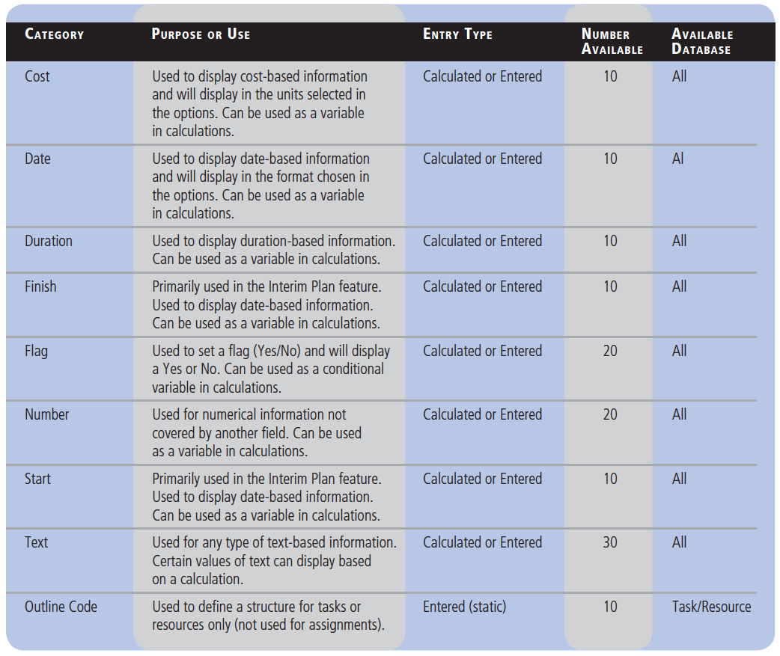
Step by Step: Create a Custom Text Field
The table at right displays all nine categories, their primary purpose and use, the type of entry, number of fields available in each, and in which database these fields can be used.

Slide 35
Step by Step: Create a Custom Text Field
Custom fields can make the difference between a mediocre Microsoft Project schedule file and a great Microsoft Project schedule file.
When planning your project, ensure there is justification to set up custom fields.
In other words, collecting and recording data simply because the option is available does not mean it is necessarily a good idea. The data you collect and record should add value.

Slide 36
Creating and Editing Tables
Within Microsoft Project are a number of different tables that can be used in various views.
These tables contain most of the commonly used data fields.
However, you can create new tables that contain exactly the data you want, such as custom fields, or you can modify any predefined table to meet your needs.

Slide 37
Step by Step: Create a Custom Table
OPEN the Don Funk Music Video 8MA project schedule. SAVE the file as Don Funk Music Video 8A.
1. Click the View tab. Then click Tables and then click More Tables. The More Tables dialog box appears and displays all of the predefined tables available to you, depending on the type of view currently displayed (task or resource).
2. Confirm that the Task button is selected as the Tables option. Select Entry, and then click the Copy button. The Table Definition dialog box appears.
3. In the Name box, key Music Video Schedule Table. Check the check box to the right of the Name box labeled Show in menu. Now you will customize the table.

Slide 38
Step by Step: Create a Custom Table
4. In the Field Name column, select the following field names and then click Delete Row after selecting each field name.
5. In the Field Name column, click the down-arrow in the next empty cell below Start, and then type or select Cast (Text1) from the dropdown list.
6. In the Align Data column in the same row, select Left. In the Width column, type or select 50.
7. In the Field Name column in the next empty row below Cast, select Location(Text 2) from the dropdown list.
8. In the Align Data column in the same row, select Left. In the Width column, type or select 30.

Slide 39
Step by Step: Create a Custom Table
9. In the Field Name column, select Start, and then click the Cut Row button.
10. In the Field Name column, select Name, and then click the Paste Row button.
11. In the Align Data column in the Start row, select Left. In the Width column, type or select 30.
12. In the Align Data column in the Name row, select Left. In the Width column, type or select 60.

Slide 40
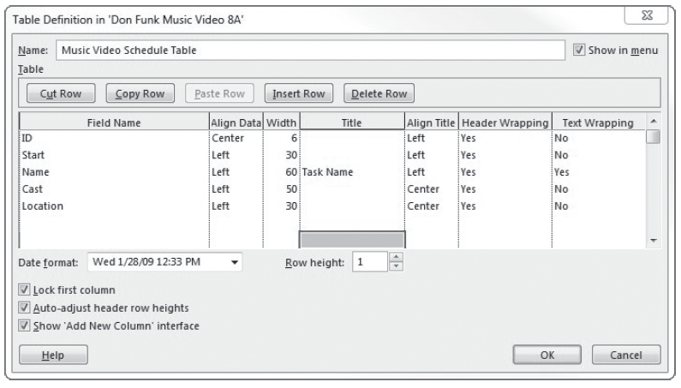
Step by Step: Create a Custom Table
13. In the Date Format box, select Wed 1/28/09 12:33 pm. Your screen should look similar to the figure below.
14. Click OK to close the Table Definition dialog box. The new table is highlighted in the More Tables dialog box.

Slide 41
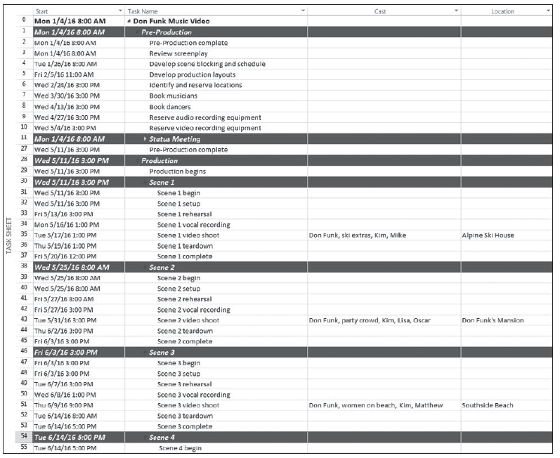
Step by Step: Create a Custom Table
15. Click Apply. Microsoft Project applies the new table to the Task Sheet view. Your screen should look similar to the figure at right.
16. SAVE the project schedule.
PAUSE. LEAVE the project schedule open to use in the next exercise.

Slide 42
Step by Step: Create a Custom Table
In this exercise, you created a custom table to display the information typically found on a video shooting schedule.
You modified an existing table to include additional data that was important to your project schedule.
As you create future project schedules, keep in mind that you have three options when setting up tables: you can create a new table, redefine an existing table, or copy an existing table and modify it as needed.
Also note that as you modify any table, you are changing the definition of that table.

Slide 43
Creating Custom Views
Almost all of the work you perform in Microsoft Project is done in a view, which allows you to see your project schedule in a useful way.
Microsoft Project includes numerous predefined views. You can use these views, edit an existing view, or create your own view.
In this exercise, you will create a custom view using the custom filter and custom table you created in earlier lessons.

Slide 44
Step by Step: Create a Custom View
USE the project schedule you created in the previous exercise.
1. On the View ribbon, click the down-arrow under the Gantt Chart button in the Task Views group, then click More Views. The More Views dialog box appears, displaying all of the predefined views available to you.
2. Click the New button. The Define New View dialog box appears. Most views use only a single pane, but a view can consist of two separate panes.
3. Make sure Single View is selected, and then click OK. The View Definition dialog box appears.

Slide 45
Step by Step: Create a Custom View
4. In the Name box, key Music Video Schedule View.
5. In the Screen box, select Task Sheet from the dropdown list.
6. In the Table box, select Music Video Schedule Table from the dropdown list. The specific groups in the dropdown list depend on the type of view you selected in step 5 (task or resource).
7. In the Group box, select No Group from the dropdown list. The specific groups in the dropdown list again depend on the type of view you selected in step 5.

Slide 46
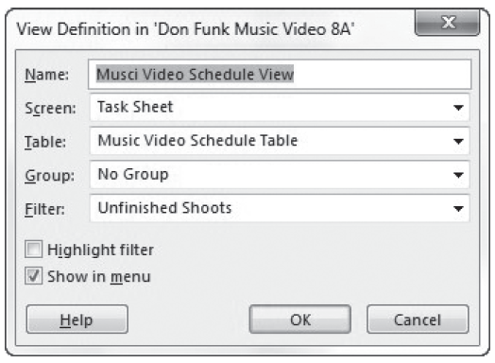
Step by Step: Create a Custom View
8. In the Filter box, select Unfinished Shoots from the dropdown list. The specific groups in the dropdown list depend on the type of view you selected in step 5. The View Definition dialog box shows all the elements that can make up a view. Your screen should look similar to the figure above.

Slide 47
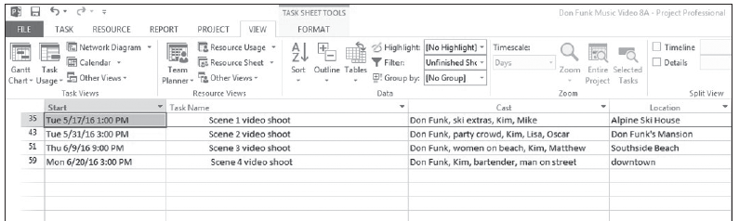
Step by Step: Create a Custom View
9. Select the Show in Menu check box, and then click OK to close the View Definition dialog box. The new view appears and should be selected in the More Views dialog box.
10. Click Apply. Microsoft Project applies the new view. Your screen should look similar to the figure below.
Notes:
Take Note: When you select the Show in Menu check box, Microsoft Project adds the new view to the View bar. This custom view will be saved with this Microsoft Project data file. You have the option to save all custom items in the Global.MPT (the global template) file, so they are available each time you use Project.

Slide 48
Step by Step: Create a Custom View
11. SAVE the project schedule. CLOSE the project schedule.
PAUSE. If you are continuing to the next lesson, keep Project open. If not continuing to additional lessons, CLOSE Project.
In this exercise, you created a custom view that enabled you to look specifically at information that was of interest to you.
Recall that a view is a window through which you can see the various elements of a project schedule in a way that is helpful to the viewing audience.
As you’ve seen, a view might contain elements such as tables, groups, or filters. You can combine these with other elements to create almost limitless custom views to suit any purpose.

Slide 49
Skill Summary

